Slide 1

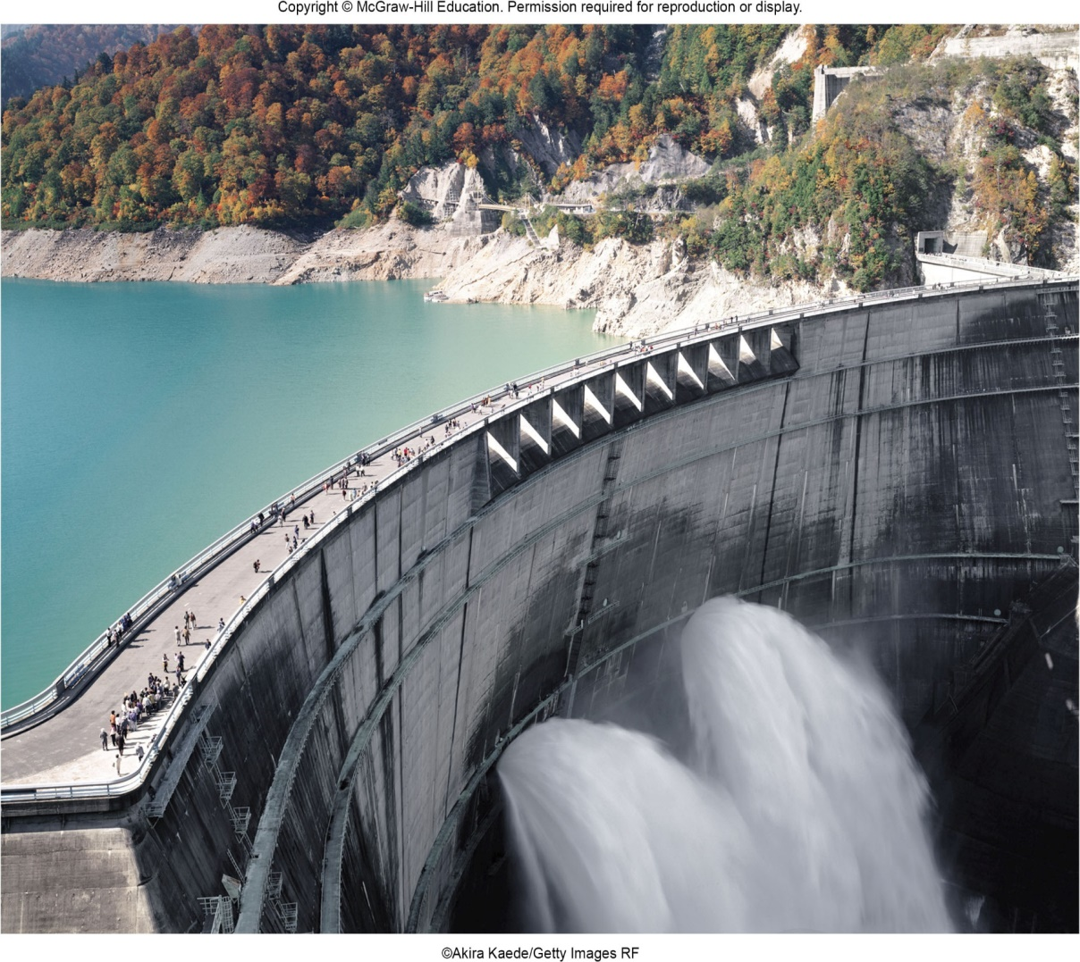
VECTOR MECHANICS FOR ENGINEERS
By: Fardinand P. Beer; E. Russell Johnston, Jr.; David F. Mazurek
ENGINEERING 3120
STATICS
CHAPTER 5
DISTRIBUTED FORCES
CENTROIDS AND CENTER OF GRAVITY
Slides revised by:
A.A. KHANDKER, Ph.D., P.E.
Copyright: McGraw Hill Education

Slide 2
DISTRIBUTED FORCES - TOPICS IN CHAPTER 5
Introduction
Center of Gravity of a 2D Body
Centroids and First Moments of Areas and Lines
Centroids of Common Shapes of Areas
Centroids of Common Shapes of Lines
Composite Plates and Areas
Sample Problem 5.1
Determination of Centroids by Integration
Sample Problem 5.4
Theorems of Pappus-Guldinus
Sample Problem 5.7
Distributed Loads on Beams
Sample Problem 5.9
Center of Gravity of a 3D Body: Centroid of a Volume
Centroids of Common 3D Shapes
Composite 3D Bodies
Sample Problem 5.12

Slide 3
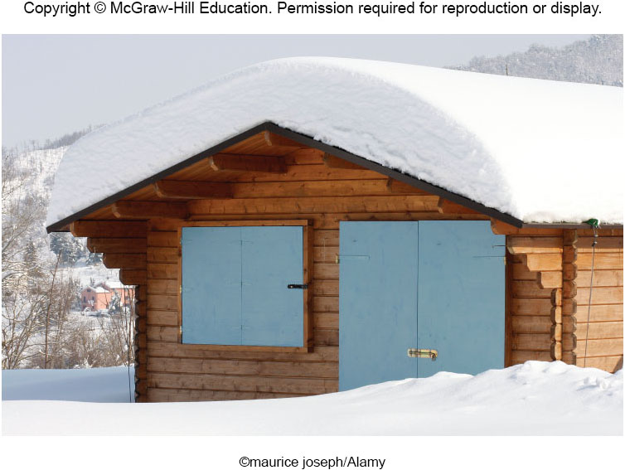
DISTRIBUTED FORCES - INTRODUCTION
There are many examples in engineering analysis of distributed loads. It is convenient in some cases to represent such loads as a concentrated force located at the centroid of the distributed load.
The earth exerts a gravitational force on each of the particles forming a body
These forces can be replace by a single equivalent force equal to the weight of the body and applied at the center of gravity for the body.
The centroid of an area is analogous to the center of gravity of a body. The concept of the first moment of an area is used to locate the centroid.
Determination of the area of a surface of revolution and the volume of a body of revolution are accomplished with the Theorems of Pappus-Guldinus.

Slide 4
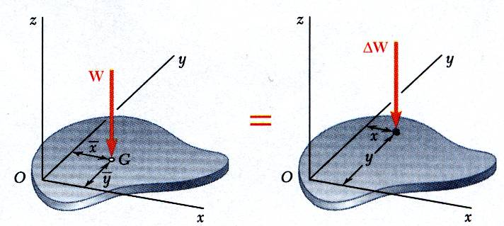
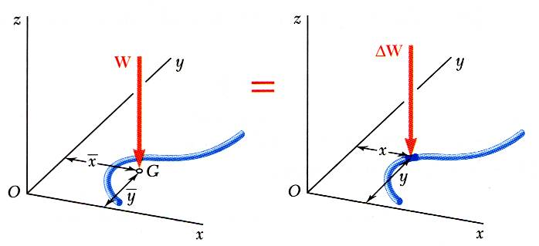
CENTER OF GRAVITY OF A 2D BODY
Center of gravity of a plate
Center of gravity of a wire

Slide 5
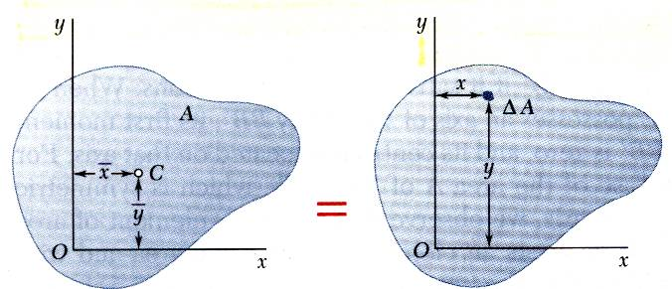
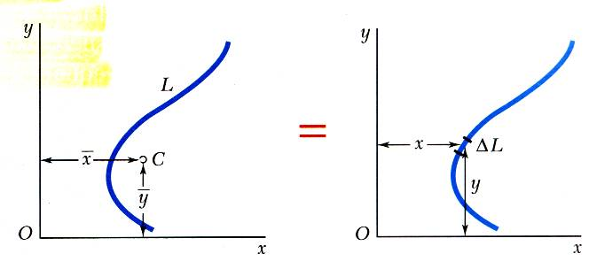
CENTROIDS OF AREAS AND LINES
Centroid of an area
Centroid of a line

Slide 6
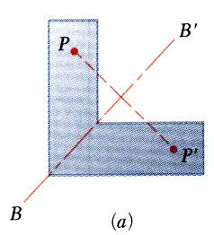
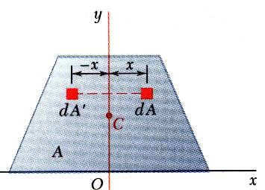
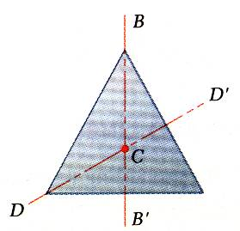
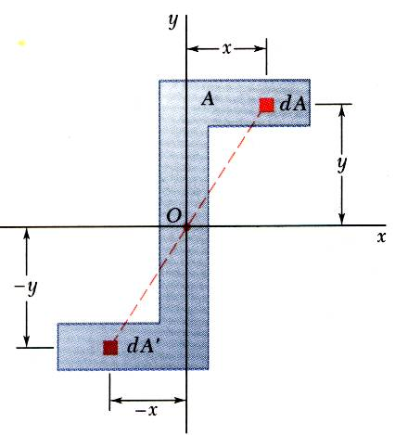
FIRST MOMENTS OF AREAS AND LINES
An area is symmetric with respect to an axis BB’ if for every point P there exists a point P’ such that PP’ is perpendicular to BB’ and is divided into two equal parts by BB’.
The first moment of an area with respect to a line of symmetry is zero.
If an area possesses a line of symmetry, its centroid lies on that axis
If an area possesses two lines of symmetry, its centroid lies at their intersection.
An area is symmetric with respect to a center O if for every element dA at (x,y) there exists an area dA’ of equal area at (-x,-y).
The centroid of the area coincides with the center of symmetry.

Slide 7
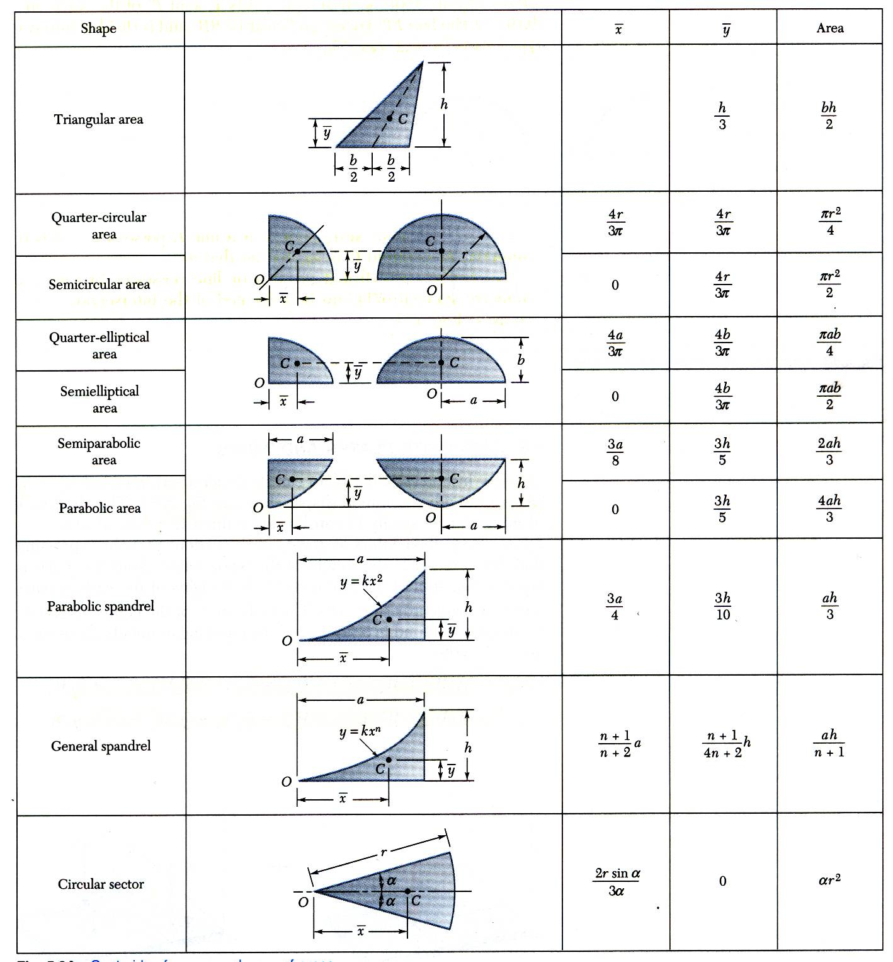
CENTROIDS OF COMMON SHAPES OF AREAS

Slide 8
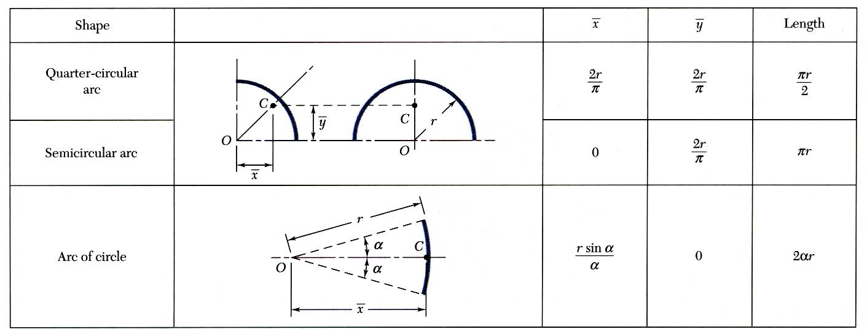
CENTROIDS OF COMMON SHAPES OF AREAS

Slide 9
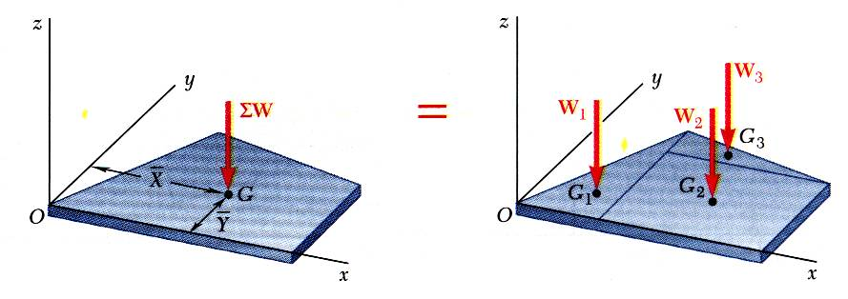
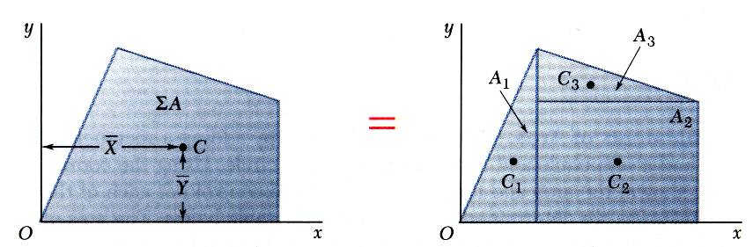
COMPOSITE PLATES AND AREAS
Composite plates
Composite area

Slide 10
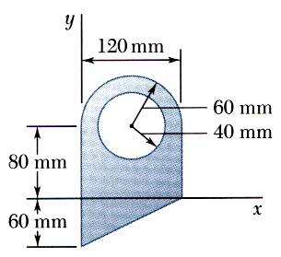
EXAMPLE PROBLEM 5.1
STRATEGY:
Divide the area into a triangle, rectangle, and semicircle with a circular cutout.
Calculate the first moments of each area with respect to the axes.
Find the total area and first moments of the triangle, rectangle, and semicircle. Subtract the area and first moment of the circular cutout.
Compute the coordinates of the area centroid by dividing the first moments by the total area.
For the plane area shown, determine the first moments with respect to the x and y axes and the location of the centroid.

Slide 11
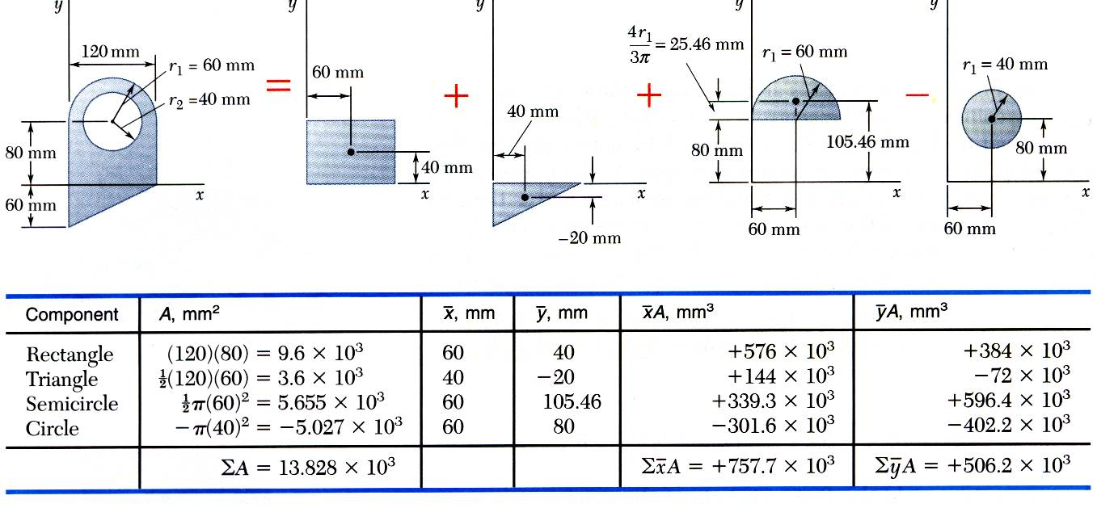
EXAMPLE PROBLEM 5.1 - SOLUTION
MODELING:
Find the total area and first moments of the triangle, rectangle, and semicircle. Subtract the area and first moment of the circular cutout.

Slide 12
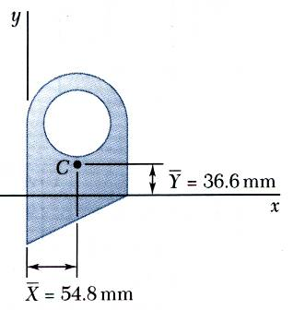
EXAMPLE PROBLEM 5.1 – SOLUTION (continued)
ANALYSIS:
Compute the coordinates of the area centroid by dividing the first moments by the total area.
REFLECT and THINK: Given that the lower portion of the shape has more area to the left and that the upper portion has a hole, the location of the centroid seems reasonable upon visual inspection.

Slide 13
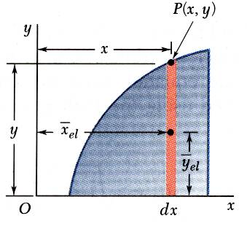
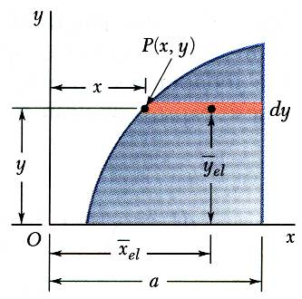
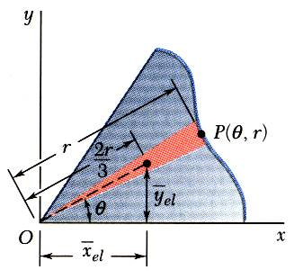
DETERMINATION OF CENTROIDS BY INTEGRATION
Double integration to find the first moment may be avoided by defining dA as a thin rectangle or strip.

Slide 14
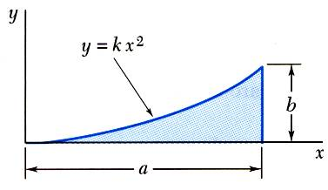
EXAMPLE PROBLEM 5.4
STRATEGY:
Determine the constant k.
Evaluate the total area.
Using either vertical or horizontal strips, perform a single integration to find the first moments.
Evaluate the centroid coordinates.
Determine by direct integration the location of the centroid of a parabolic spandrel.

Slide 15
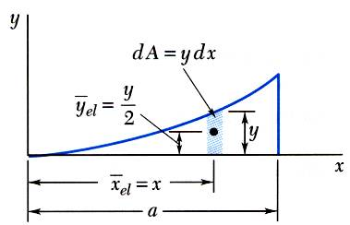
EXAMPLE PROBLEM 5.4 - SOLUTION
MODELING
Determine the constant k.
ANALYSIS
Evaluate the total area.

Slide 16
EXAMPLE PROBLEM 5.4 – SOLUTION (continued)
Using vertical strips, perform a single integration to find the first moments.

Slide 17
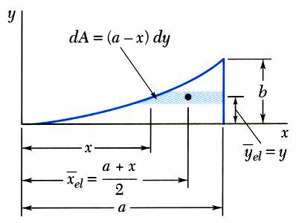
EXAMPLE PROBLEM 5.4 – SOLUTION (continued)
Alternatively, using horizontal strips, perform a single integration to find the first moments.

Slide 18
EXAMPLE PROBLEM 5.4 – SOLUTION (continued)
Evaluate the centroid coordinates.
REFLECT and THINK:
You obtain the same results whether you choose a vertical or a horizontal element of area, as you should. You can use both methods as a check against making a mistake in your calculations.

Slide 19
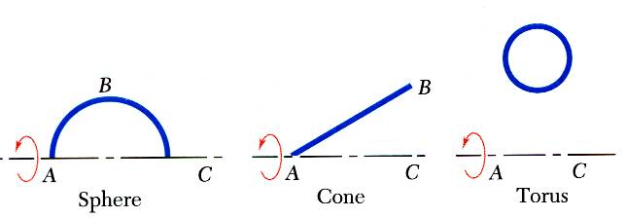
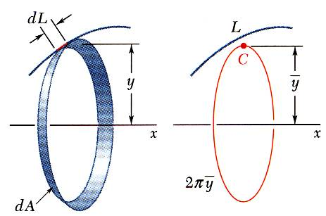
THEOREMS OF PAPPUS-GULDINUS
Surface of revolution is generated by rotating a plane curve about a fixed axis.
Area of a surface of revolution is equal to the length of the generating curve times the distance traveled by the centroid through the rotation.

Slide 20
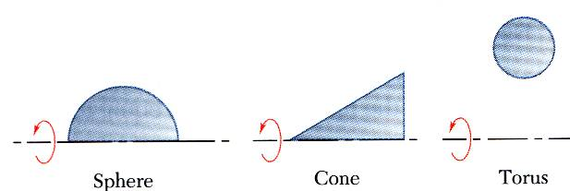
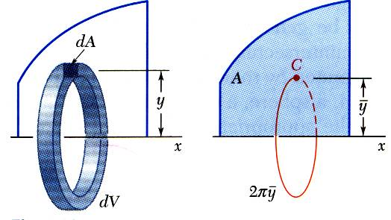
THEOREMS OF PAPPUS-GULDINUS
Body of revolution is generated by rotating a plane area about a fixed axis.
Volume of a body of revolution is equal to the generating area times the distance traveled by the centroid through the rotation.

Slide 21
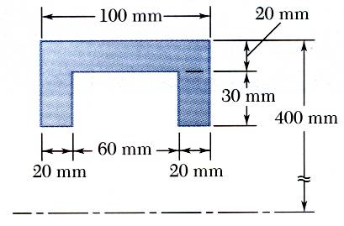
EXAMPLE PROBLEM 5.7
The outside diameter of a pulley is 0.8 m, and the cross section of its rim is as shown. Knowing that the pulley is made of steel and that the density of steel is
determine the mass and weight of the rim.
Apply the theorem of Pappus-Guldinus to evaluate the volumes of revolution for the rectangular rim section and the inner cutout section.
Multiply by density and acceleration to get the mass and acceleration.
STRATEGY:

Slide 22
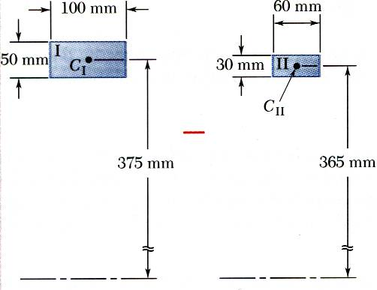
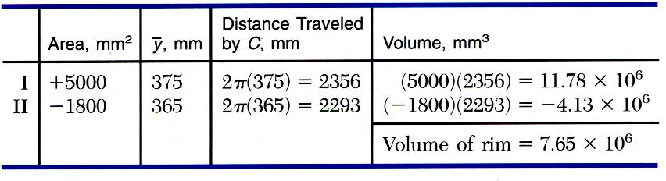
EXAMPLE PROBLEM 5.7 - SOLUTION
MODELING:
Apply the theorem of Pappus-Guldinus to evaluate the volumes or revolution for the rectangular rim section and the inner cutout section.
Multiply by density and acceleration to get the mass and acceleration.
ANALYSIS:

Slide 23
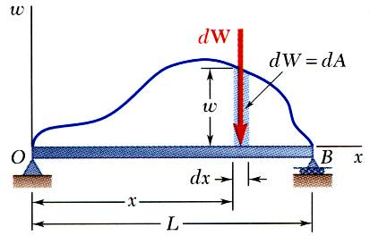
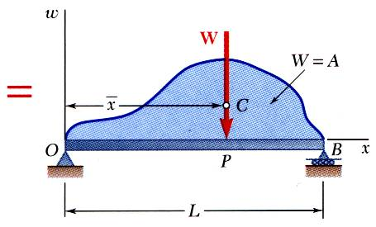
DISTRIBUTED LOADS ON BEAMS
A distributed load is represented by plotting the load per unit length, w (N/m) . The total load is equal to the area under the load curve.
A distributed load can be replace by a concentrated load with a magnitude equal to the area under the load curve and a line of action passing through the area centroid.

Slide 24
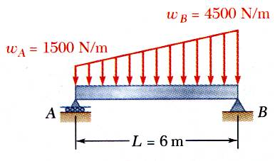
EXAMPLE PROBLEM 5.9
A beam supports a distributed load as shown. Determine the equivalent concentrated load and the reactions at the supports.
STRATEGY:
The magnitude of the concentrated load is equal to the total load or the area under the curve.
The line of action of the concentrated load passes through the centroid of the area under the curve.
Determine the support reactions by summing moments about the beam ends.

Slide 25
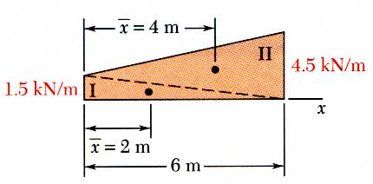
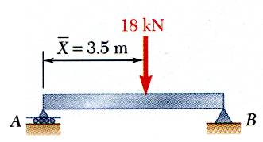
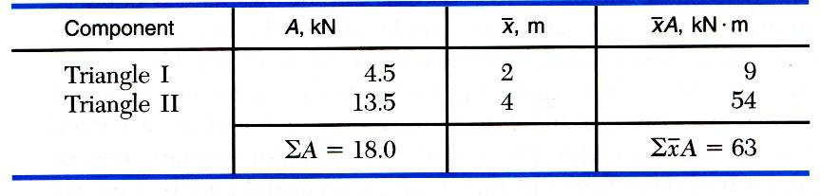
EXAMPLE PROBLEM 5.9 - SOLUTION
MODELING and ANALYSIS:
The magnitude of the concentrated load is equal to the total load or the area under the curve.
The line of action of the concentrated load passes through the centroid of the area under the curve.

Slide 26
EXAMPLE PROBLEM 5.9 – SOLUTION (continued)
Determine the support reactions by summing moments about the beam ends.
And by summing forces in the x-direction
REFLECT and THINK:
You can replace the given distributed load by its resultant, which you found in part a. Then you can determine the reactions from the equilibrium equations

Slide 27
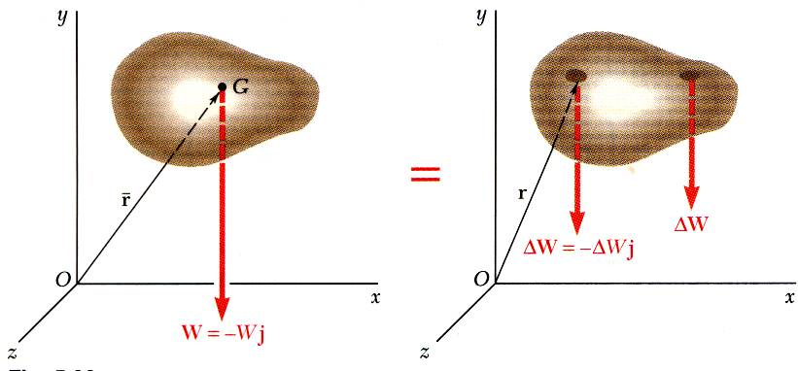
THREE-DIMENSIONAL BODY CENTER OF GRAVITY AND CENTROID
Center of gravity G
Results are independent of body orientation,
For homogeneous bodies,

Slide 28
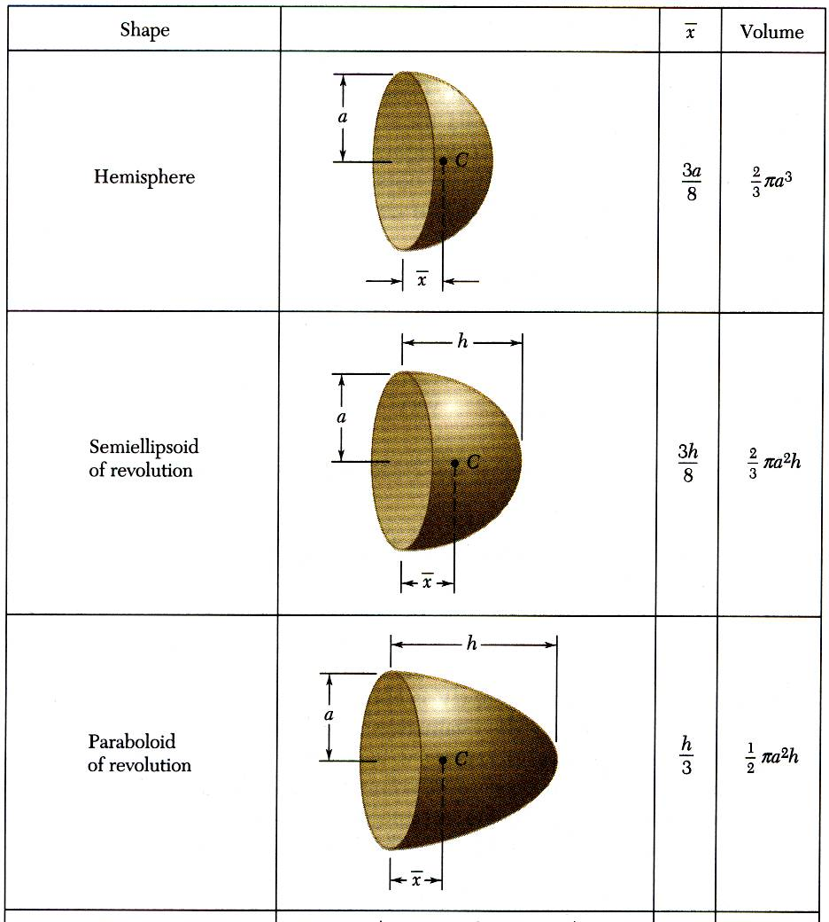
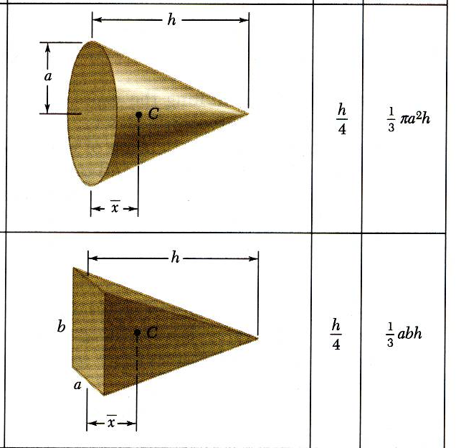
CENTROID OF COMMON 3D SHAPES
SHAPE
Cone
Hemisphere
Pyramid
Semi-Ellipsoid of Revolution
Paraboloid of Revolution

Slide 29
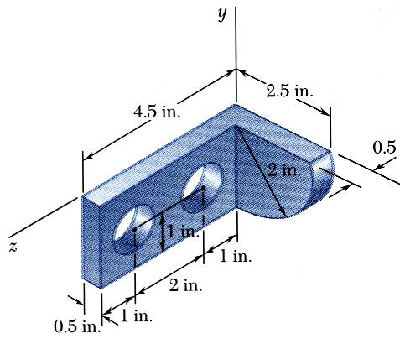
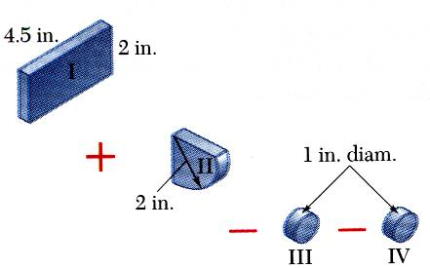
COMPOSITE OF 3D BODIES
Moment of the total weight concentrated at the center of gravity G is equal to the sum of the moments of the weights of the component parts.
For homogeneous bodies,

Slide 30
EXAMPLE PROBLEM 5.12
STRATEGY:
Form the machine element from a rectangular parallelepiped and a quarter cylinder and then subtracting two 1-in. diameter cylinders.
Locate the center of gravity of the steel machine element. The diameter of each hole is 1 in.

Slide 31
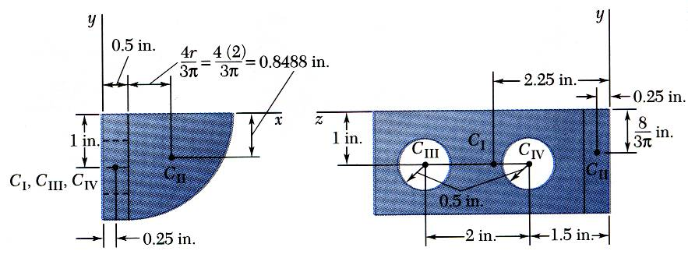
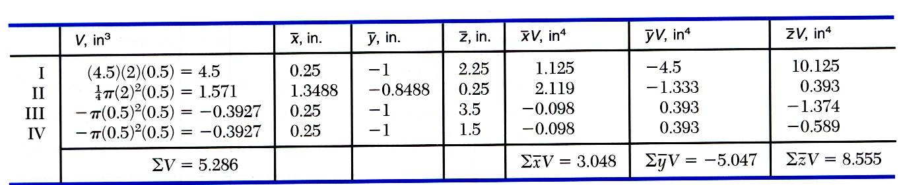
EXAMPLE PROBLEM 5.12 - SOLUTION
MODELING:
ANALYSIS:
End of Chapter 5

